Slide 1

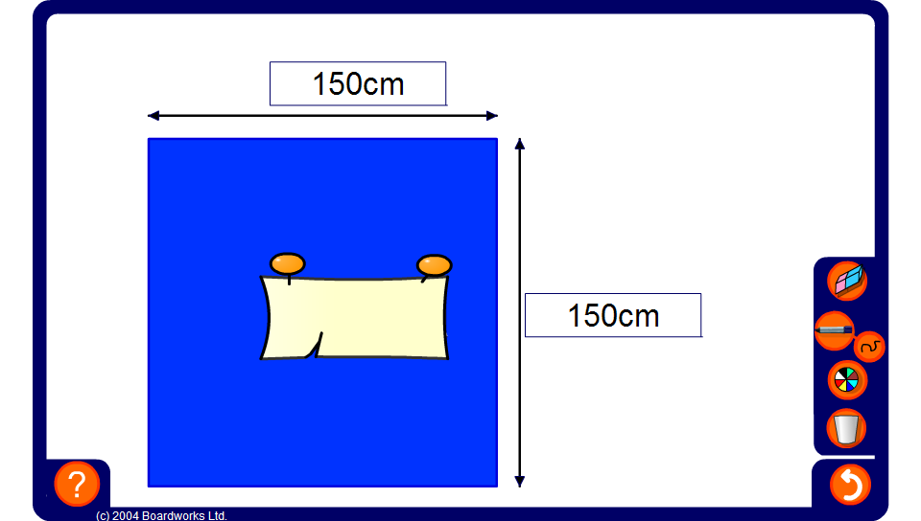


Square roots
Notes:
Reveal the area of the square and ask pupils to work out the lengths of the sides.
Alternatively, reveal the length of one of the sides and ask pupils to work out the length of the other side and the area.

